Slide 1
Beginning of the Year Procedures
Jay Johnson

Slide 2




Arrival to Class
Do your best to arrive
on time and be ready
to learn each day. Get hand sanitizer as you come through the door.
Put away your jacket, backpack, and any other items you bring from home.
Have a seat, greet the classmates seated near you, login and get started.
Prepare for a great
day of learning!

Slide 3



Please bring to class each day
Good attitude
Pencils
Composition Notebook
Highlighters
Earbuds

Slide 4


Pencil sharpening
Please sharpen your pencil, if needed, before you login.
Mechanical pencils
are also allowed!

Slide 5

Nurse visits, restroom, and drink breaks
If you need to use the restroom, you may go to the restroom on the way to homeroom, before/after lunch and at each class change.
If you have an emergency, you must get a pass and go to the front office to use the restroom.
If you don’t feel well, let me know and get a pass to the nurse.
Water fountains and restrooms are closed during class time for cleaning purposes.

Slide 6



Assignments
Using your class time wisely will decrease the amount of work you need to complete at home.
We will have a warm up, activity period and student led closing each day.
Assignments will be listed on your homepage in Canvas. Most assignments will be submitted through Canvas.
If you aren’t sure about something, just ask.

Slide 7
Dismissal from Class.
After the student led closing, we will logout and pack up.
01
Students will be dismissed either individually or by rows to line up at the exit.
02
If going back to your grade, we will walk as a class back to your area. Get hand sanitizer on the way out the door.
03

Slide 8




How and when to contact me?
I want you to have a great and successful year!
You may visit with me about questions or concerns any time we are not in the middle of direct instruction, or I am not helping other students.
You may email me if necessary, and I will respond when I am able.
I am available for extra help before or after school. When possible, please let me know in advance so I can plan accordingly. Tutoring is offered each Tuesday am at 7:45

Slide 9

When is the appropriate time to have a positive attitude and be respectful?
ALWAYS! Do your best to be respectful and have a positive attitude each day. We are going to have a fantastic year!

Slide 10
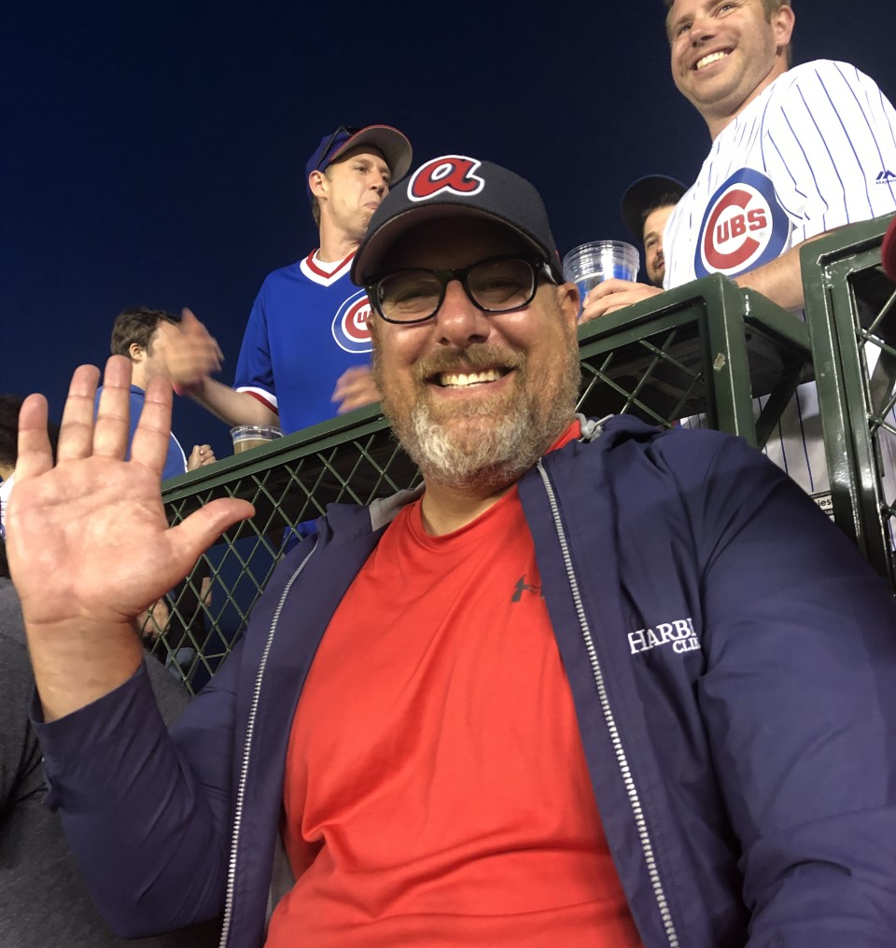
Misbehavior in class.
1. Warning, redirection or seat change
2. Teacher Conference & Phone Call
3. Guidance Conference & Phone Call
4. In Team Time Out or Detention
5. Office Referral

